Slide 1
Trash Sorting AI
By Winston and Evan

Slide 2
TABLE OF CONTENTS
01
02
03
04
Introduction
Gathering and preparing data
Machine learning model
Evaluation and considerations

Slide 3
Introduction

Slide 4
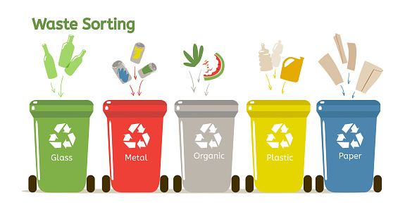
ABOUT PROJECT
Our trash sorting AI aims to distinguish items into categories such as glass, metal, trash, plastic when the item is presented on the camera or when a picture file is given.

Slide 5
01
Gathering Data

Slide 6
Gathering data
Used online images and placed them in their respective categories
Brought our own recyclables and took photos of them from as many angles and backgrounds as possible

Slide 7
02
Processing Data

Slide 8
Processing Data
Tried to take as much data as possible for each category
Our current model was giving us outputs mainly due to the background instead of the item itself
Placed them in different angles and backgrounds to prevent external factors from influencing the result

Slide 9
03
Machine Learning Model

Slide 10
Model
Supervised learning

Slide 11
04
Evaluation

Slide 12
Evaluation Process

Slide 13
Results
Precision | Accuracy

Slide 14
Deployment

Slide 15
Design Thinking Factors
Empathise :
Define :
Ideate :
Prototype:
Test:

Slide 16
Face Detection AI
By Winston and Evan

Slide 17
TABLE OF CONTENTS
01
02
03
04
Introduction
Gathering and preparing data
Machine learning model
Evaluation and considerations

Slide 18
Introduction

Slide 19


ABOUT PROJECT
Detect suspicious looking individual through analyzing facial features to get face shapes
SUS

Slide 20
01
Gathering Data

Slide 21
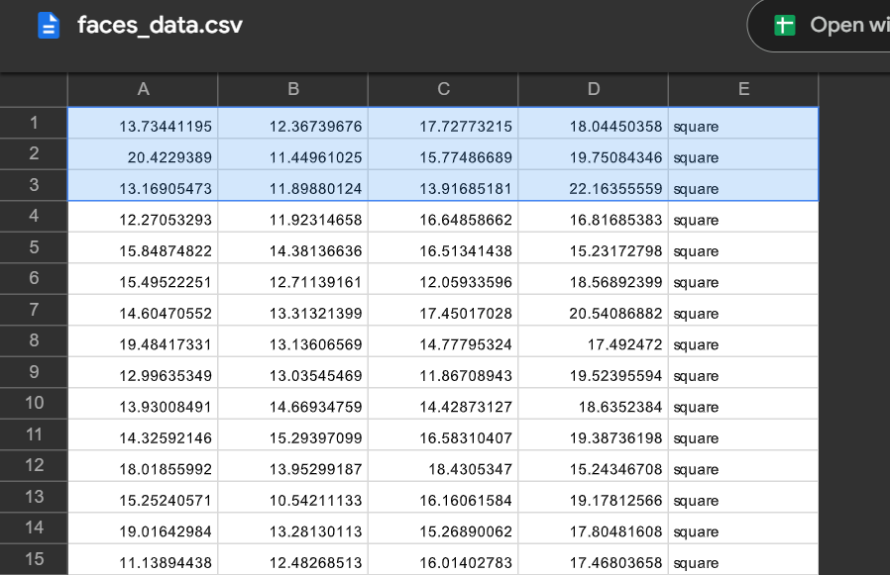

Gathering data
Data courtesy of our instructor

Slide 22
02
Processing Data

Slide 23
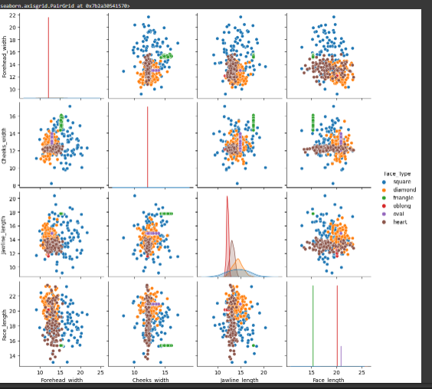
Processing Data
Using seaborn to visualise the data

Slide 24
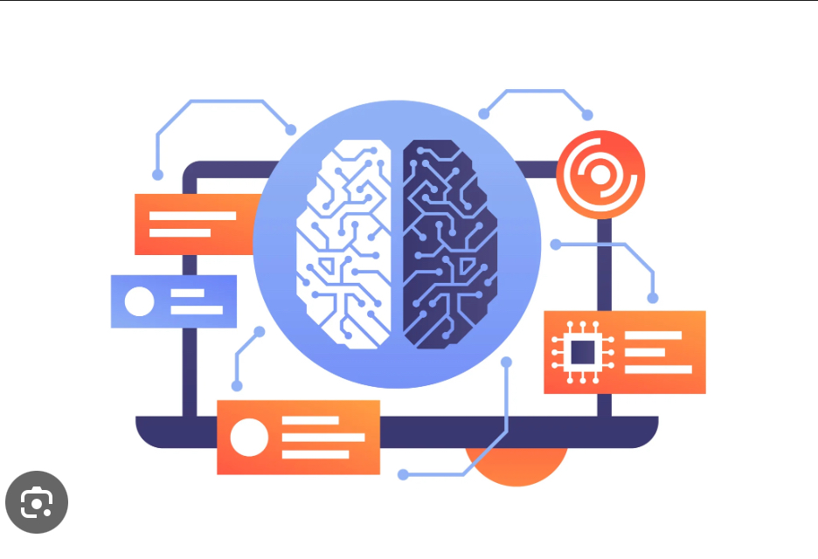
03
Machine Learning Model

Slide 25
Model
Support vector machines
Supervised learning
Decision tree classifier
Kneighbourclassifier

Slide 26

04
Evaluation

Slide 27
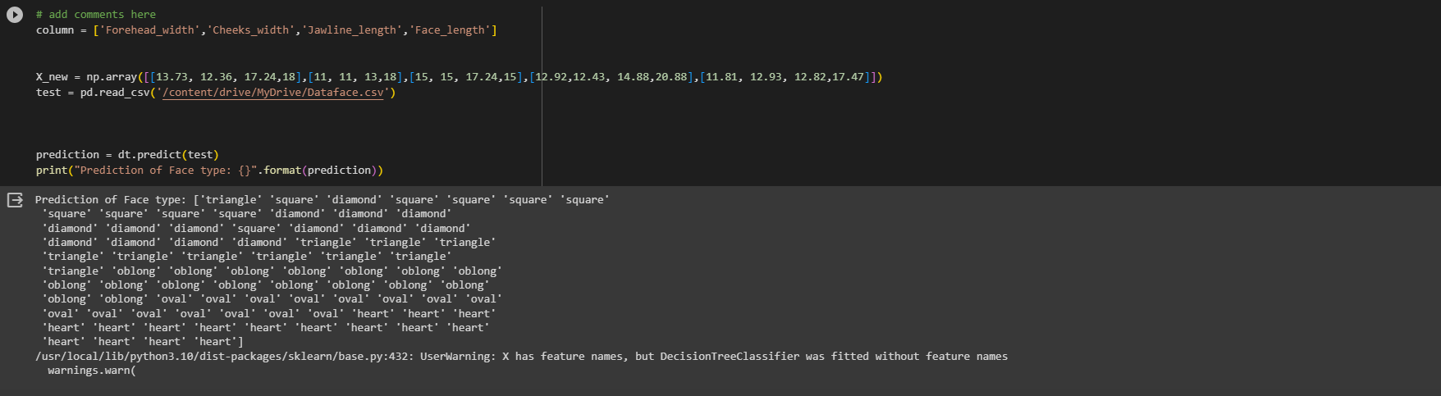
Evaluation Process
We tested the model against a new set of data and obtained readings

Slide 28
Results
We unfortunately do not know true accuracy as no shape was given for the the new set of data

Slide 29
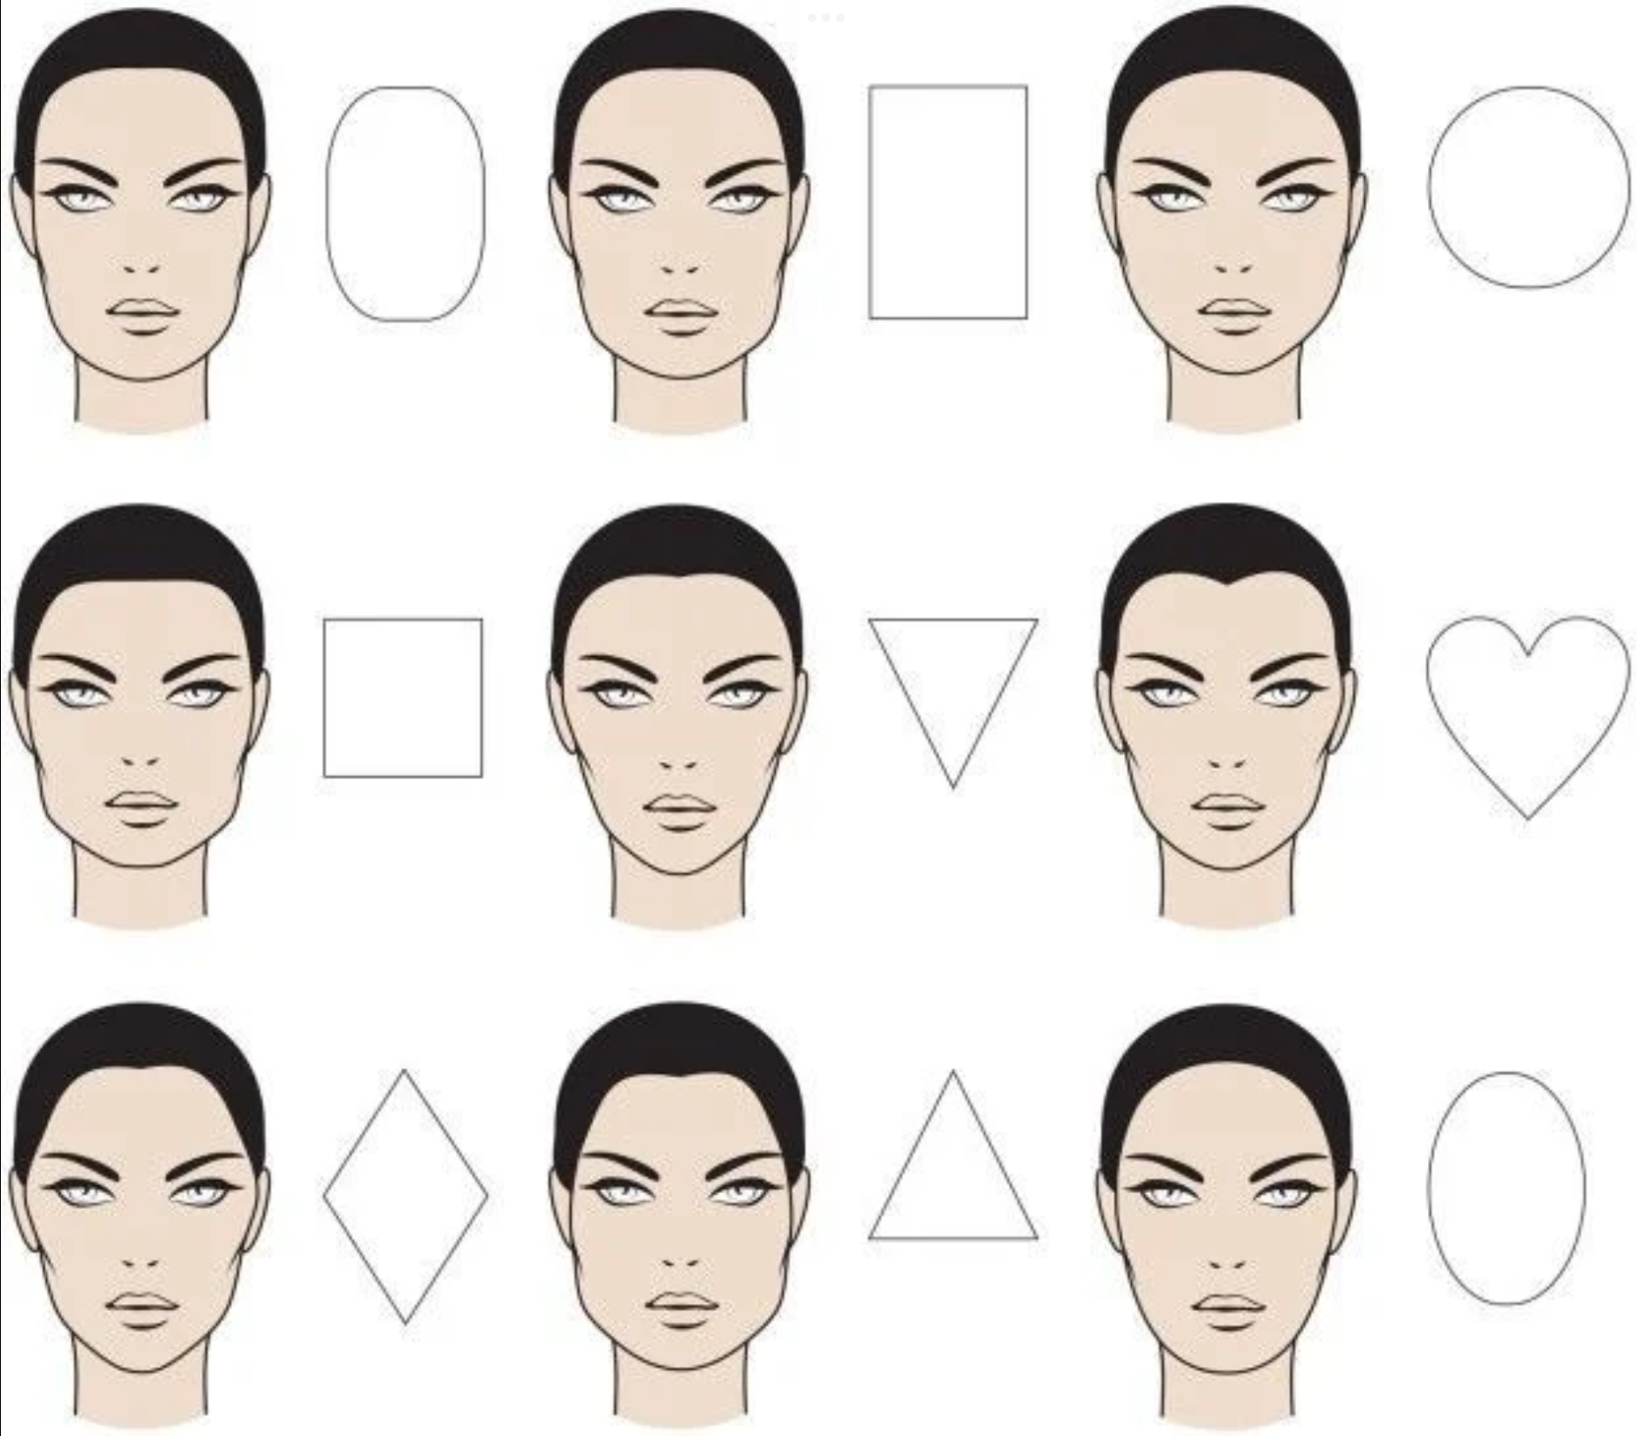
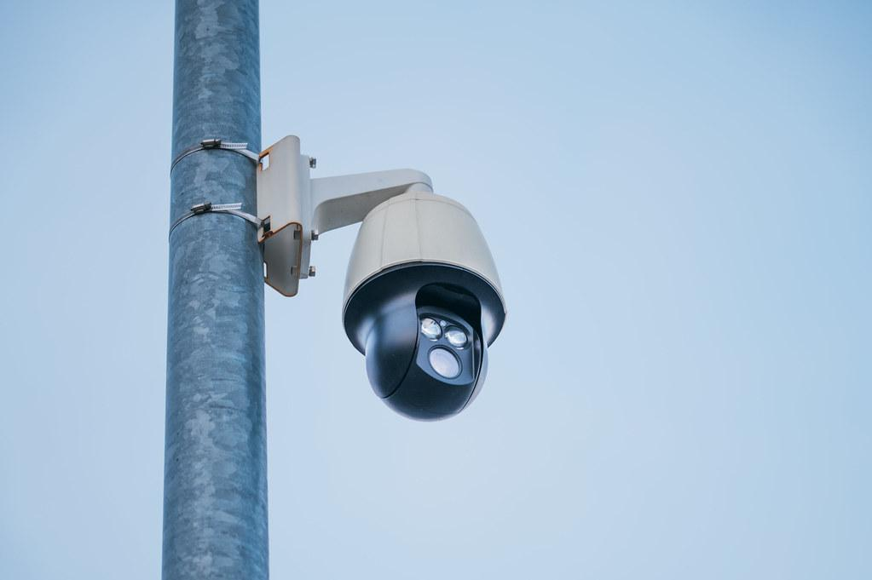
Deployment
Detect sus people on our home security
Allow people to find out their face shape

Slide 30
Design Thinking Factors
Empathise : It is difficult to tell our own face shape accurately using our eyes
Define : Design an app that is able to take measurements of your facial features and tell you your face shape , Aesthetics, beauty
Ideate : Computer vision to take measurements of special facial features
Prototype: Model can be improved by gathering more data
Test: Feedback can be given by its accuracy

Slide 31
Thank You!

Slide 32
